Slide 1
Transforming Riders
Cyclistic Trip Data Analysis
March 2, 2023
Katherine Tetlak, Bradford Analytics
Notes:
Cyclistic’s future growth depends on transforming casual riders into subscribing members. This presentation shows how casual riders differ from members in an effort to identify trends that will help the company develop effective strategies for such a transformation.

Slide 2
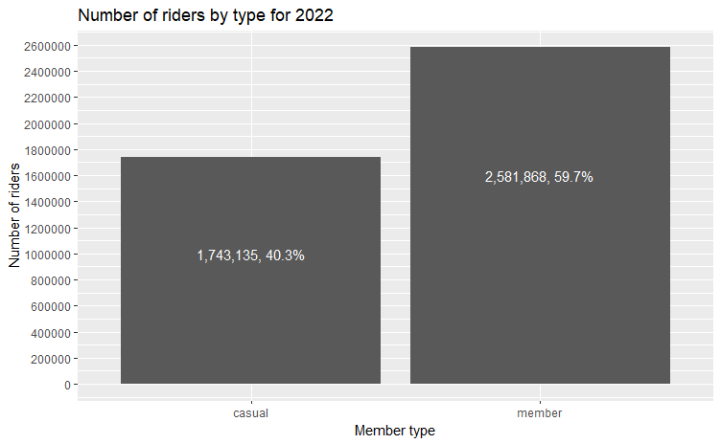
Casual riders make up about 40% of total riders
Notes:
Casual riders make up approximately 40% of total riders, which gives us a significant source of potential members.

Slide 3
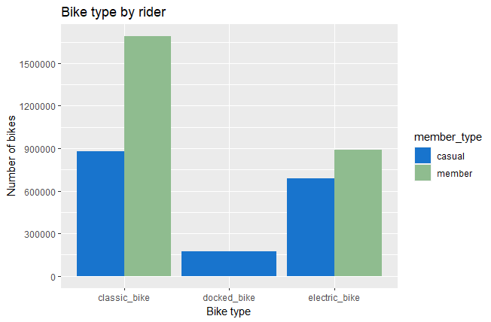
Classic bikes are the preferred type among both types of riders
Notes:
Docked bikes are the least used among the three types of bikes, and annual members do not use them at all. Members overwhelmingly choose classic bikes and they do so approximately twice as often as they choose electric bikes. Casual riders predominantly choose classic bikes, with electric bikes chosen somewhat less frequently.

Slide 4
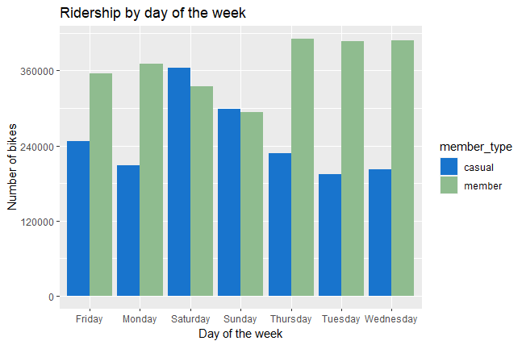
Casual riders prefer to ride on Saturday and Sunday
Notes:
Bike use among casual riders is highest on the weekend, Saturday and Sunday, with Friday seeing somewhat less use. The other weekdays see fairly consistent use among casual riders. The most prominent days for bike use among members are Tuesday, Wednesday, and Thursday, with Monday and Friday seeing somewhat less frequent use. Thus, bike use is highest among members during the week and highest among casual riders on the weekend. This implies that members use bikes for commuting, whereas casual riders use them for pleasure.

Slide 5
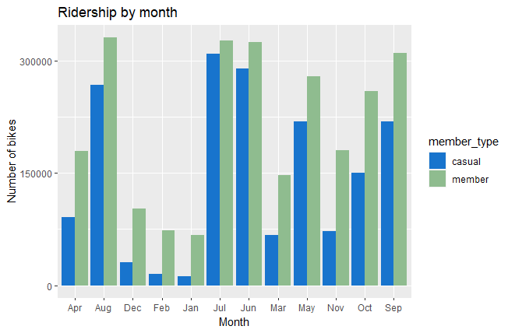
Bike use among casual riders is highest in June, July, and August
Notes:
The summer months of June, July, and August have the highest number of casual riders, followed by May and September. However, bike use among casual riders never exceeds that among members. The winter months of December, January, and February, have very low ridership among casual riders.

Slide 6
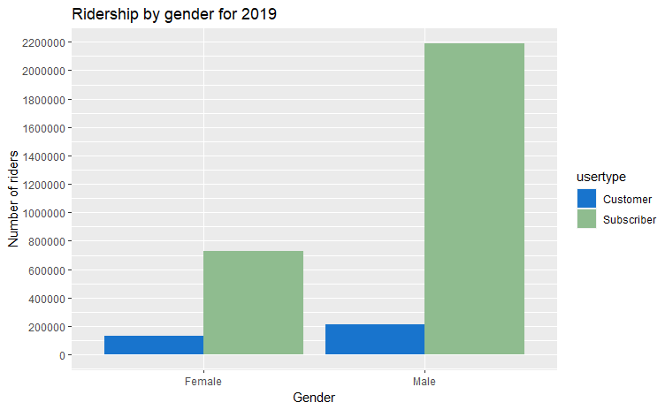
Bike use among women is quite low for both rider types
Notes:
There are far fewer female riders than male riders. There isn't a significant difference in the number of casual riders by gender, but there is in the number of members by gender. A random survey may reveal possible causes for the discrepancy.

Slide 7
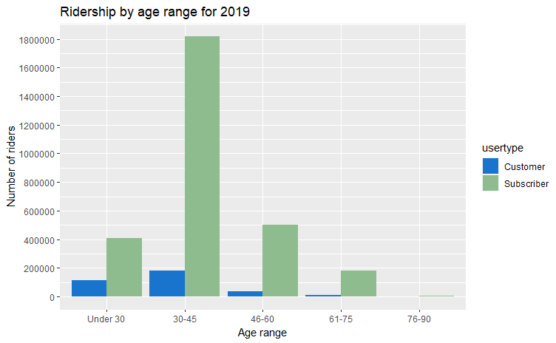
Bike use predominates among those 30-45 years old
Notes:
It is clear from the analysis that members are primarily those in the 30-45 age range. This also applies to casual riders, although the numbers are far lower than those of members.

Slide 8
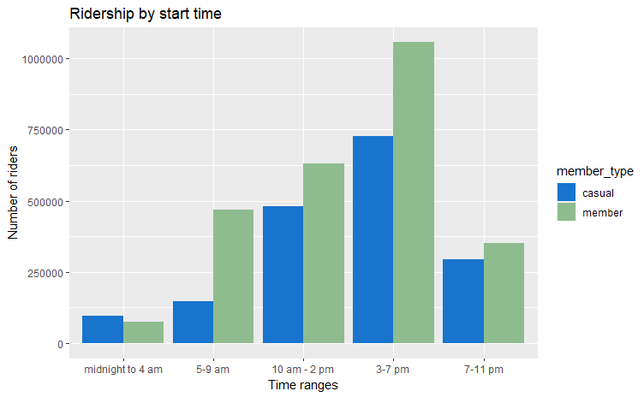
Casual riders prefer riding between 3 and 7 pm
Notes:
The data show that ridership among members far outweighs that of casual riders from 5-9 am and from 3-7 pm, which seems to corroborate the assumption that members tend to use bikes to commute to and from work. The time of greatest ridership for casual riders is 3 to 7 pm, followed by the 10 am to 2 pm time range. It's interesting to note that there are riders between midnight and 4 am; this is the only case in which casual riders outnumber members.

Slide 9
Commuting to work
Winter riding
Ridership among women
Summary of Analysis:
Notes:
The analysis shows that ridership among members is highest during the week, whereas that among casual riders is highest on the weekends. This may imply that members use bikes to commute to work, which suggests that membership may increase if casual riders are encouraged to commute to work. Winter riding is another area to be explored; ridership among casual riders is almost non-existent in the winter months, but it’s higher for members, suggesting that casual riders think there’s no point in purchasing an annual membership if they aren’t riding year-round. The last area to be explored is ridership among women. The numbers are quite low for both casual riders and members. It may be possible to tap this underrepresented resource by addressing their specific needs.

Slide 10
Survey to assess needs of female riders.
Develop a marketing campaign that encourages casual riders to use bikes to commute to work. Promote health benefits, benefits to environment (reduced pollution), benefits to city (reduced congestion). Emphasize accommodations the city has made (or will commit to making) for such use.
Develop a marketing campaign that shows different ways bikes can be used in winter, i.e., getting to local winter events, sights to see in winter, etc. As part of the campaign, provide suggestions on how to prepare for winter riding and address concerns regarding safety, i.e., icy roads, etc. Again, if the city has made or will commit to making winter riding safer, that would be a good selling point.
Next steps:

